Slide 1
Prediction of health status based on Body Mass Index (BMI)
-By 02- Amreen Kazi, 09- Pratiksha Panda
-MSc Data Science

Slide 2
index
Introduction
Literature Review
Problem Statement
Solution : Why AI Integration ?
The Dataset
Data Preprocessing
Heatmap: Finding the Correlation
Model selection
XGBoost regressor
Prediction

Slide 3
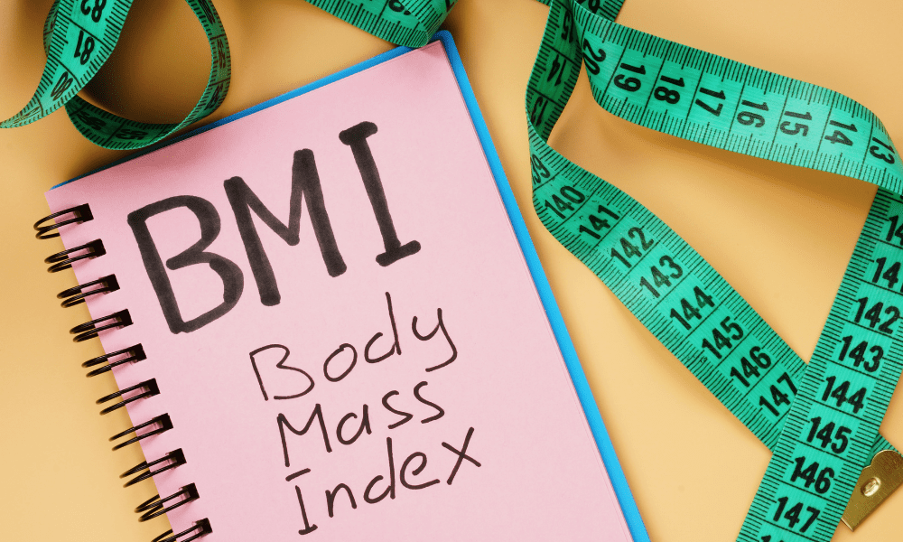
Introduction
In recent years, the use of advanced technologies, particularly Artificial Intelligence (AI), has shown significant promise in the field of healthcare.
Body Mass Index (BMI) serves as a crucial indicator for evaluating an individual's body status.
For our research, we have selected four specific research papers that focus on BMI prediction.
Through our examination of these papers, we aim to gain valuable insights into the current state of BMI prediction and identify the problems for improvement.

Slide 4
Literature Review
BMI Prediction using Kinect and Data Mining Techniques on Mobiles.
[Chih-Hua Tai , et. al, 2015]
Recommended Weight Prediction System Based on BMI, BMR, Food Calorie and a Neural Network.
[Anilkumar Kothalil Gopalakrishnan, 2017]
The Prediction of Body Mass Index from Negative Affectivity through Machine Learning.
[Giovanni Delnevo, et al., 2021]
Predicting obesity rate and obesity-related healthcare costs using data analytics.
[Stephanie Revelsa, et al., 2017]

Slide 5
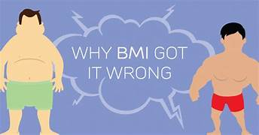
Problem Statement
Existing methods for predicting health status based on BMI
Often lack accuracy.
Fail to consider other relevant factors.
There is a need for an advanced AI-powered solution that can effectively predict health status based on BMI.

Slide 6
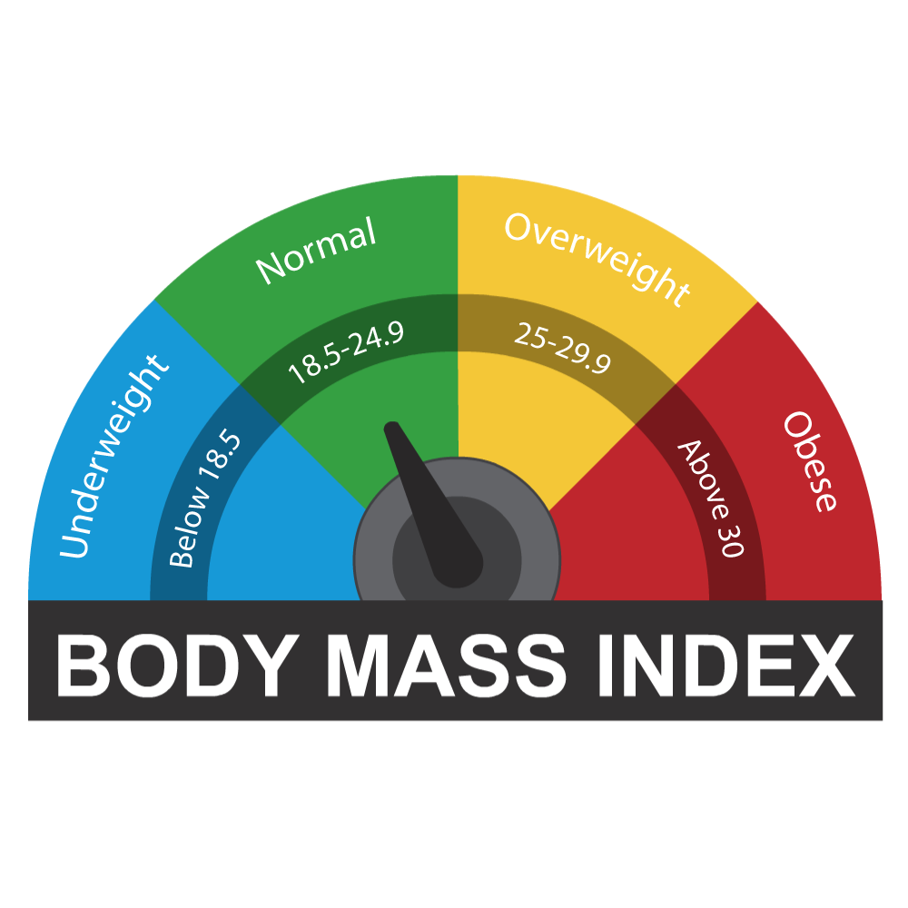
SOLUTION : Integration of AI with traditional methods

Slide 7
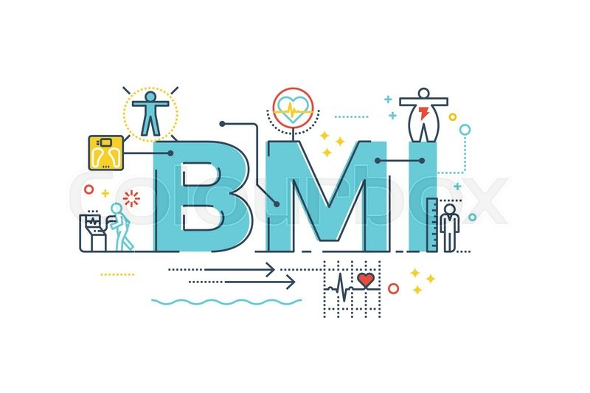
Why AI integration?
AI integration in calculating BMI (Body Mass Index) and predicting health issues can significantly improve accuracy.
AI-powered systems can process and analyze data much faster than humans, enabling quick and efficient calculations of BMI and identification of potential health issues.
AI integration allows for personalized calculations and predictions based on individual characteristics and health data.
AI algorithms can identify patterns and correlations in large datasets that may not be apparent to human observers.
AI-powered systems have the ability to continuously learn and improve their predictions and recommendations over time.

Slide 8
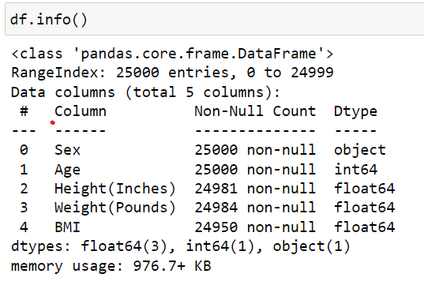
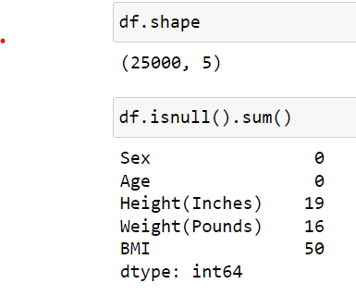
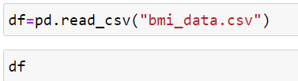
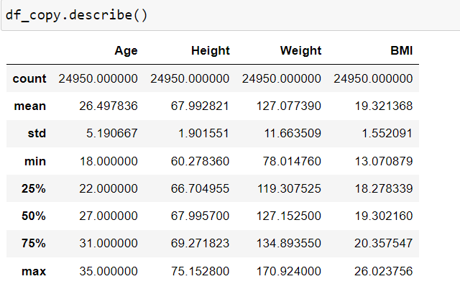
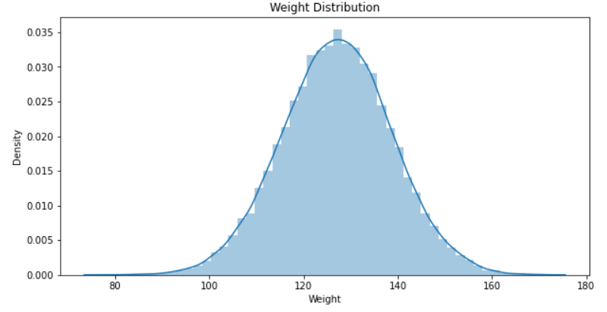
The Dataset : Knowing the data

Slide 9
Data Preprocessing
Method 1 : Dropping nulls
Method 2 : Filling the null values using central tendencies - Mean, Median or Mode

Slide 10
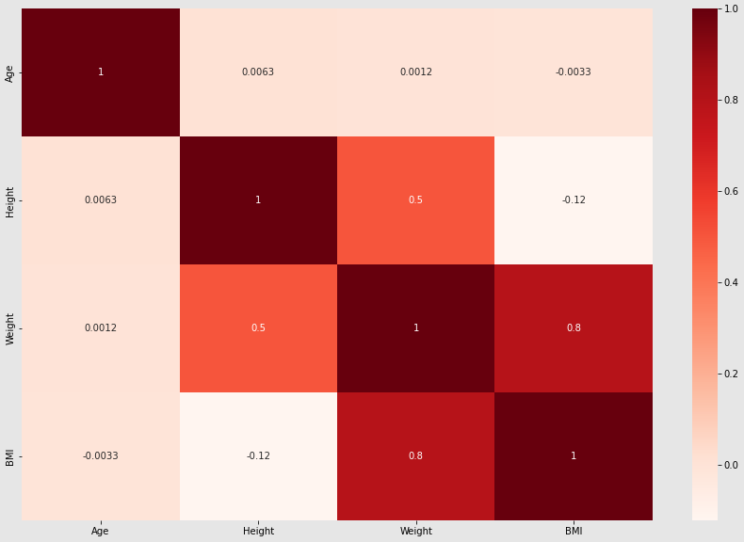
Heatmap: Finding the Correlation
Method 1- Dropping nulls Method 2- Filling nulls using central tendencies

Slide 11
Data Pre processing
Renaming the column headers
Encoding Sex Columns using One hot encoder
Separating the target column from the source data to compare with the predictions later
Scaling the data values using standard scaler
Splitting the data
Creating a Predictive Data model using XGBRegressor

Slide 12
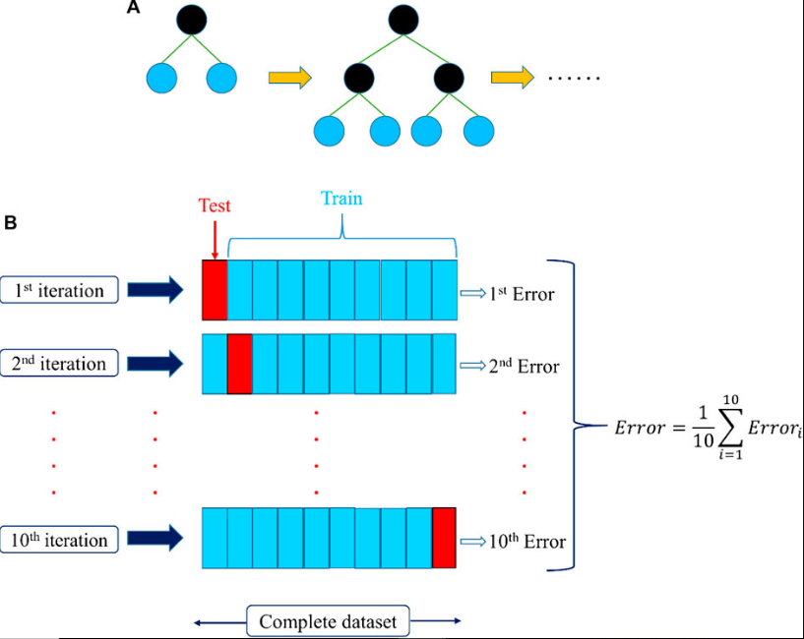
XGBoost regressor
A type of highly accurate machine learning model that is used to predict continuous numerical values.
It is able to handle both linear and non-linear relationships between the features and the large dataset.
A relatively simple algorithm to understand and implement.

Slide 13
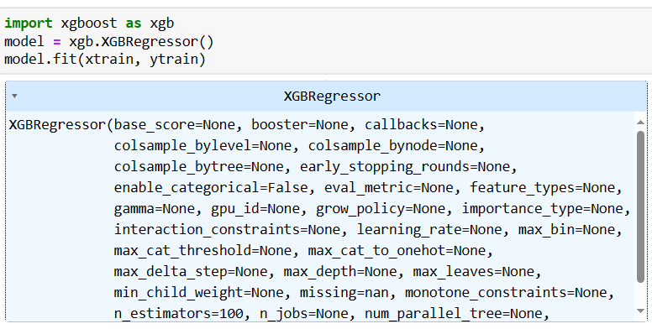
Model selection
Xgbootser regressor

Slide 14
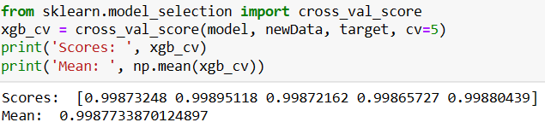
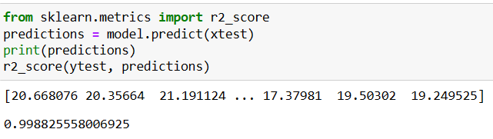
prediction

Slide 15
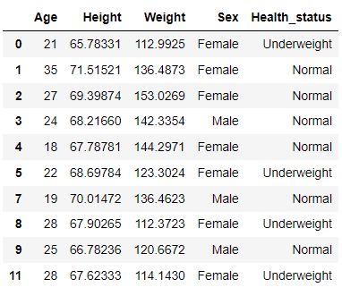
Health Prediction using model
Health Predicted by model categorized as Underweight, Normal, Overweight, Obese, Extreme Obese

Slide 16
Conclusion
Prediction of health status based on BMI can be improved with AI.
XGBoost is a highly effective regression algorithm that can make very accurate predictions.
This project can help the medical industry by predicting health status with high accuracy.
There is still room for improvement, as healthcare and AI are constantly evolving.

